Slide 1

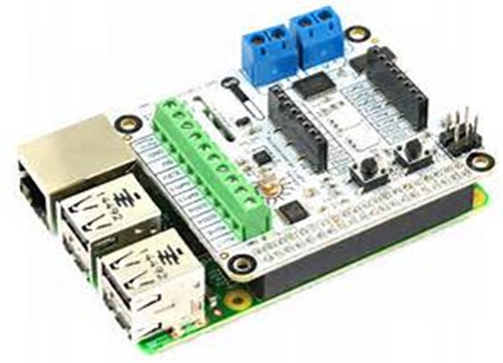
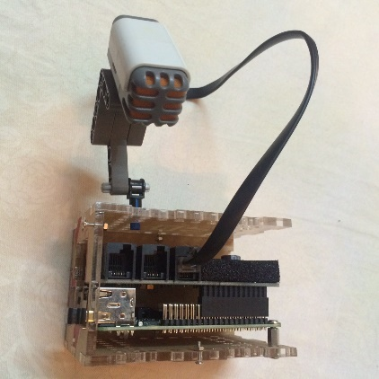
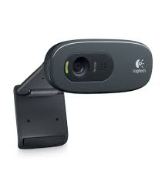







Raspberry Pi 1.2B, with Raspbian OS, BrickPi and Lego Minstorm Sound Sensor
Raspberry Pi 2, with Windows 10 IOT Core, FEZ HAT(Temperature, Humidity etc) and Camera
IOT Hub
Sound Intensity REST API (Python)
Push Sound Intensity, Temperature, humidity etc
Steam Analytics
Get Sound Intensity Data
UWP Application
Fit-Bite Pet Sensor Prototype
SQL Azure Database
Sensor data for pet and health records
Push Pet Images to Blog Storage
ML Service
PetBot Web App
Get Health Prediction
Azure Blog Storage
Slack Client
Get Pet Image
Azure Function
Pet Owner
Pet Images Container
Chat Channel
Check Pet Health
Azure Storage Client
Check Pet Health
Pet Owner
Azure Function
Send sound intensity threshold breach alert
Sound intensity threshold alert Function
Pet Owner

